Slide 1
Walk Through the WIKI: Resources for Educators on How to Modify Curriculum and Instruction for Students with Disabilities
National Center and State Collaborative Approach to Defining and Teaching Content
California Common Core State Standards Symposium
for Special Educators
December 2, 2013
Sarah Kennedy
Notes:
The National Center and State Collaborative (NCSC) is a project led by five centers and 24 states (Tier 1 and Tier 2) including Washington D.C. and the Pacific Assessment Consortium to build an alternate assessment based on alternate achievement standards (AA-AAS) for students with significant cognitive disabilities.
The goal of the NCSC project is to ensure that students with the most significant cognitive disabilities achieve increasingly higher academic outcomes and leave high school ready for post-secondary options.
NCSC defines a comprehensive system that will coherently address curriculum, instruction, and assessment needs in states by:
1) producing technically defensible formative, interim, and summative assessments;
2) incorporating evidence-based instruction and curriculum models; and
3) developing comprehensive approaches to professional development (PD).
This presentation focuses on the Curriculum and Instructional Resources and professional development opportunities to support teachers to provide meaningful opportunities to learn academic content for students with significant cognitive disabilities.

Slide 2
NCSC Project Goal
To develop a system of assessments
supported by curriculum, instruction and professional development to ensure that students with the most significant cognitive disabilities achieve increasingly higher academic outcomes and leave high school ready for post-secondary options.
Notes:
NCSC is developing curriculum and instructional resources and professional development support for teachers to achieve this goal.
Our state, ________________, and all NCSC partners share a commitment to the development of a comprehensive system of supports that reflects a necessary shift in teaching and learning practices for these students participating in alternate assessment and their teachers.

Slide 3
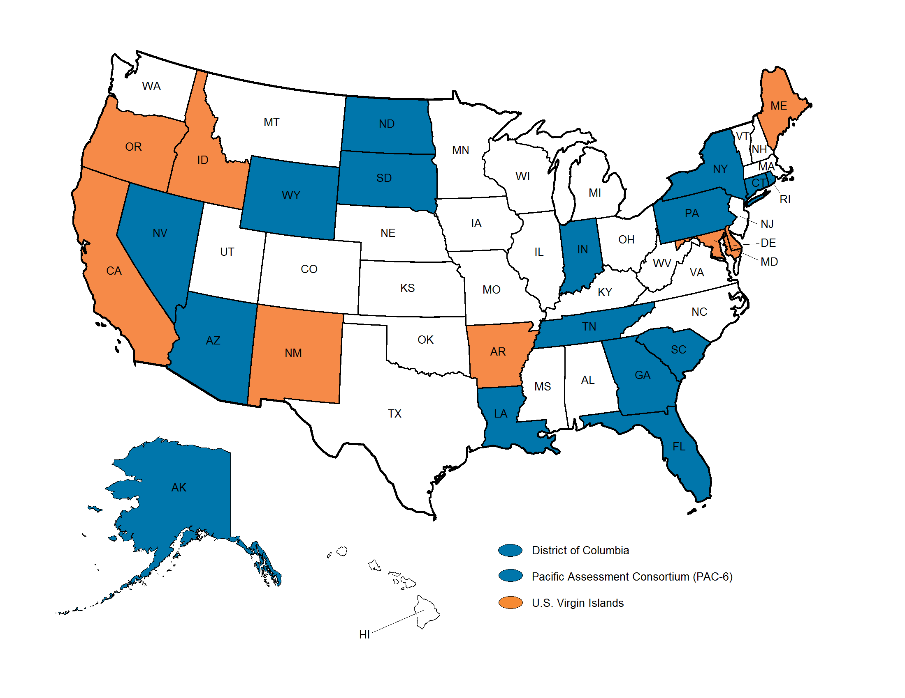
NCSC State Partners
Notes:
The organizational partners include the National Center on Educational Outcomes (NCEO) as the host and fiscal agent, along with the National Center for the Improvement of Educational Assessment (NCIEA), the University of Kentucky (UKY), University of North Carolina at Charlotte (UNCC), and edCount, LLC. There are 18 core or Tier I state partners. These include Alaska, Arizona, Connecticut, District of Columbia, Florida, Georgia, Indiana, Louisiana, Nevada, New York, North Dakota, Pacific Assessment Consortium (PAC-6), Pennsylvania, Rhode Island, South Carolina, South Dakota, Tennessee, and Wyoming. The 6 entities (American Samoa, Commonwealth of the Northern Mariana Islands, Federated States of Micronesia, Guam, Republic of Palau, and Republic of the Marshall Islands) partner as 1 state, led by the University of Guam Center for Excellence in Developmental Disabilities Education, Research, and Service (CEDDERS).
Additionally, Tier II states include: Maine, Delaware, Arkansas, Oregon, Maryland, Idaho. These states do not receive NCSC staff support but do receive ready-to-implement products and processes as well as tools and protocols used for providing beta-test feedback.

Slide 4

NCSC Organization Partners
Notes:
These are the organizational partners for the project. Their long standing expertise and current research continues to inform, support, and guide the work of the project.

Slide 5
NCSC: A Comprehensive Model
All partners share a commitment for a research-to-practice focus for the development of a comprehensive model of curriculum, instruction, assessment, and supportive professional development resources.
Notes:
All partners share a commitment to the research-to-practice focus of the project and the development of a comprehensive model of curriculum, instruction, assessment, and supportive professional development. These supports will improve the alignment of the entire system and strengthen the validity of inferences of the system of assessments.

Slide 6
Beyond the Summative Test
The NCSC long-term goal is to ensure that students with significant cognitive disabilities achieve increasingly higher academic outcomes and leave high school ready for postsecondary options.
A well-designed summative assessment alone is insufficient to achieve our purpose.
To achieve this goal, an AA-AAS system also requires:
Curricular & instructional frameworks
Teacher resources and professional development
Notes:
Our long-term goal is to ensure that students with significant cognitive disabilities achieve increasingly higher academic outcomes and leave high school ready for postsecondary options. A well-designed summative assessment alone is insufficient to achieve that goal. Thus, NCSC is developing a full system intended to support educators, which includes formative assessment tools and strategies, professional development on appropriate interim uses of data for progress monitoring, and management systems to ease the burdens of administration and documentation.

Slide 7
NCSC Overall Timeline 2013−2015
2013: Item and Test Development Phase: Task Template Tryouts, Item Specs/item development/item reviews, Student Interaction Studies (SIS), Draft grade level PLDs, finalize pilot/field design, Tech build
2014: Pilot, Field, Research Phase:
Pilot Phase 1: National Sample, generate item statistics Winter/Spring 2014, Finalize blueprints, revise items, assemble forms
Phase 2: Field Test Forms Fall 2014, finalize administration training and supports
2015: Operational administration of NCSC assessments
–Summer 2015: Set Standards
–Fall 2015: Technical reporting complete

Slide 8
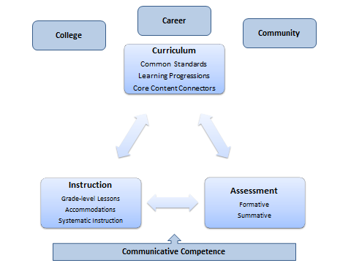
Professional Development Framework
Notes:
The NCSC staff developed a framework to guide all of our webinars. The Framework uses a triangle to identify the three key components: curriculum, instruction, and assessment. The arrows are multi-directional because each component of the triangle is used to inform the other components of the triangle. The triangle is placed upon a base: communication. Without communication, students cannot adequately access the core content because academic content by definition is symbolic in nature. Therefore, all work must start with competent communicators. Finally, the triangle is located on the background of college, career, and community – ensuring that these real world components are integrated into the system of curriculum, instruction, and assessment.

Slide 9
College, Career, and Community Ready, and AA-AAS
  Well developed academic skills for continued life-long learning
  Social and communication skills needed for working with others as essential for community ready
  Recognizing the need for and seeking assistance when needed
  Problem solving using academic skills
Kearns, Kleinert, Harrison, Shepherd-Jones, Hall, & Jones (2011). What Does College and Career Ready Mean for Students with Significant Cognitive Disabilities.
Notes:
Four components encompass college, career, and community ready for students who participate in alternate assessment:
Well developed academic skills for continued life-long learning
Social and communication skills needed for working with others as essential for community ready
Recognizing the need for and seeking assistance when needed
Problem solving using academic skills

Slide 10
Curricular and Instructional Resources
Provide guidance on how to “unpack” the instructional and assessed content;
Promote strategies and resources for teaching challenging academic content through professional development opportunities; and
Align challenging and attainable content that is observable and measurable for use in instruction and a thorough system of assessments.
Notes:
Many teachers of SSCD need guidance to know how to translate academic content standards into instruction and assessments.
Teachers are challenged by the fact that students with the most significant cognitive disabilities are a heterogeneous group with varying entry skills/points/levels into the content standards and may not know how to differentiate instruction for this population (Karvonen, Wakeman, Flowers, & Browder, 2007).
Over the past several decades, powerful insights have been gained into how students represent knowledge and develop competence in specific domains, as well as how tasks and situations can be designed to provide evidence for inferences about what students know and can do for students across a full range of performance.

Slide 11
Quality Indicators for Instructional Resources
Promote Common Core State Standards;
Set high expectations for all students;
Apply principles of Universal Design for Learning (UDL); and
Apply evidence-based teaching practices for all special education students especially those with the most significant cognitive disabilities.

Slide 12
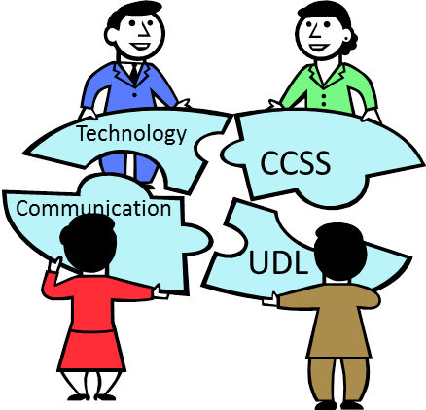
Communicative and Instructional Practices – potential changes in the classroom
  Identify the importance of using instructional and assessment technology.
  Provide access to communication within content-based instruction for every student.
  Provide multiple means of research-based presentation, representation and action, and expression (UDL).
  Provide daily, appropriate, and individualized accommodations.

Slide 13
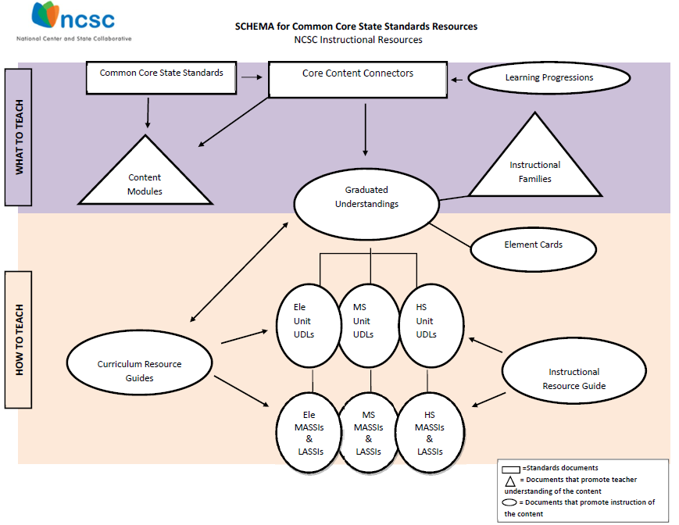

Slide 14
Common Core State Standards
Define grade level content and achievement;
Define rigorous content and skills (application knowledge);
Align with expectations for college and career success; and
Do not tell teachers how to teach, but they do help teachers figure out the knowledge and skills their students should have so that teachers can build the best lessons and environments for their classrooms.
http://www.corestandards.org/

Slide 15
Looking at 4 Interrelated Guiding Principles of Learning Progressions (Hess, 2008)
Based on available Research
The big ideas/the “essence” of concepts/processes are the binding threads
May not be linear, but articulate movement toward increased understanding (e.g., deeper, broader, ability to apply or generalize)
Go hand-in-hand with well-designed/aligned assessments
Notes:
The Learning Progressions Framework was guided by the following:
Best available research
The big ideas or essence of the concepts are the binding threads
Learning Progressions may not be linear, but they do articulate movement toward increased understanding
Learning Progressions go hand-in hand with well-designed assessments

Slide 16
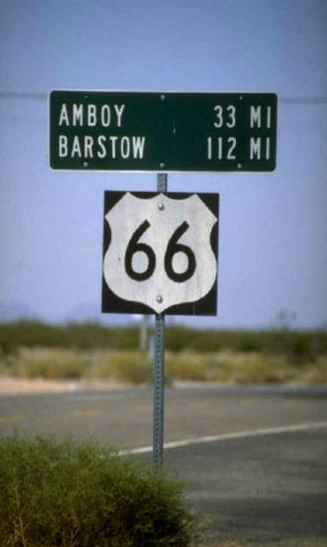

Think Map vs. Route

Slide 17
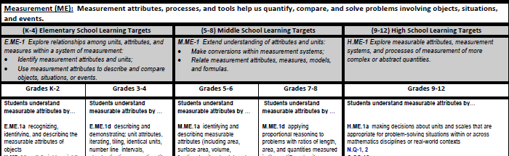
Learning Progressions
Statement of Enduring Understanding
Learning Targets
Progress Indicators

Slide 18
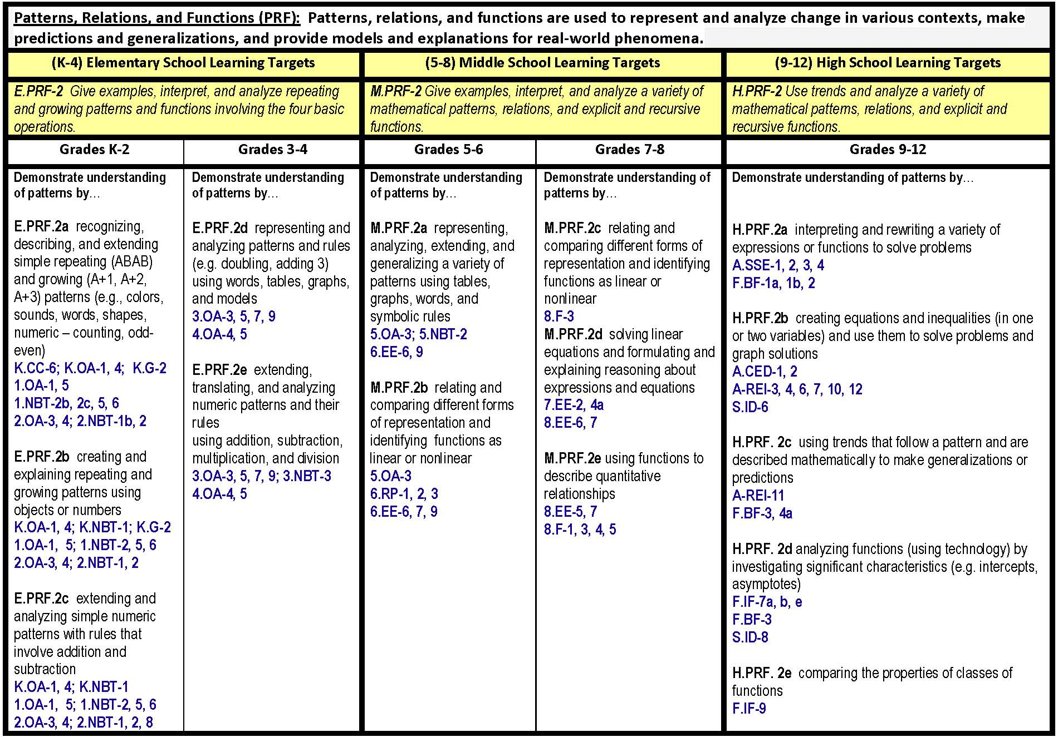
Notes:
Now let’s look at how to read the Learning progressions.
There are 6 major strands in the Learning Progressions Framework. They are Symbolic Expression, The Nature of Numbers and Operations, Measurement, Patterns Relations and Functions, Geometry, and Data Analysis Probability and Statistics. (move arrow to point to the strand).
Each Strand describes the essential learning.
Next you see the Learning targets are the more general/broad performance descriptors associated with specific skills and concepts at each grade level(arrow points to yellow boxes).
Progress Indicators describe concepts and skills along the learning continuum for a grade band (arrow points to LPI in K-2). These skills & concepts build towards successful demonstration of learning targets for the next grade band (point arrow to LPI 3-4).
Also notice that the Learning Progressions Framework identifies the Common Core State Standards that are addressed by an indicator. You will notice that an indicator may address multiple domain areas, as seen in the highlighted K-2 Indicator. CCSS Domain areas address include Counting and Cardinality, Operations and Algebraic Thinking, Geometry, and Number and Operations in Base Ten.

Slide 19

SCHEMA for Common Core State Standards Resources
NCSC Instructional Resources
Common Core State Standards
Core Content Connectors
Learning Progressions Frameworks
WHAT TO TEACH
Instructional Families
Content
Modules
Graduated Understandings
Element Cards
HOW TO TEACH
Ele Unit
UDLs
MS Unit UDLs
HS Unit UDLs
Curriculum Resource Guides
Instructional Resource Guide
Ele MASSIs &
LASSIs
MS MASSIs &
LASSIs
HS MASSIs &
LASSIs
=Standards documents
= Documents that promote teacher understanding of the content
= Documents that promote instruction of the content

Slide 20
Core Content Connectors (CCCs)
Identify the most salient grade-level, core academic content in ELA and mathematics found in both the CCSS and the LPF;
Illustrate the necessary knowledge and skills in order to reach the learning targets within the LPF and the CCSS;
Focus on the core content, knowledge and skills needed at each grade to promote success at the next; and
Identify priorities in each content area to guide the instruction for students in this population and for the alternate assessment.

Slide 21
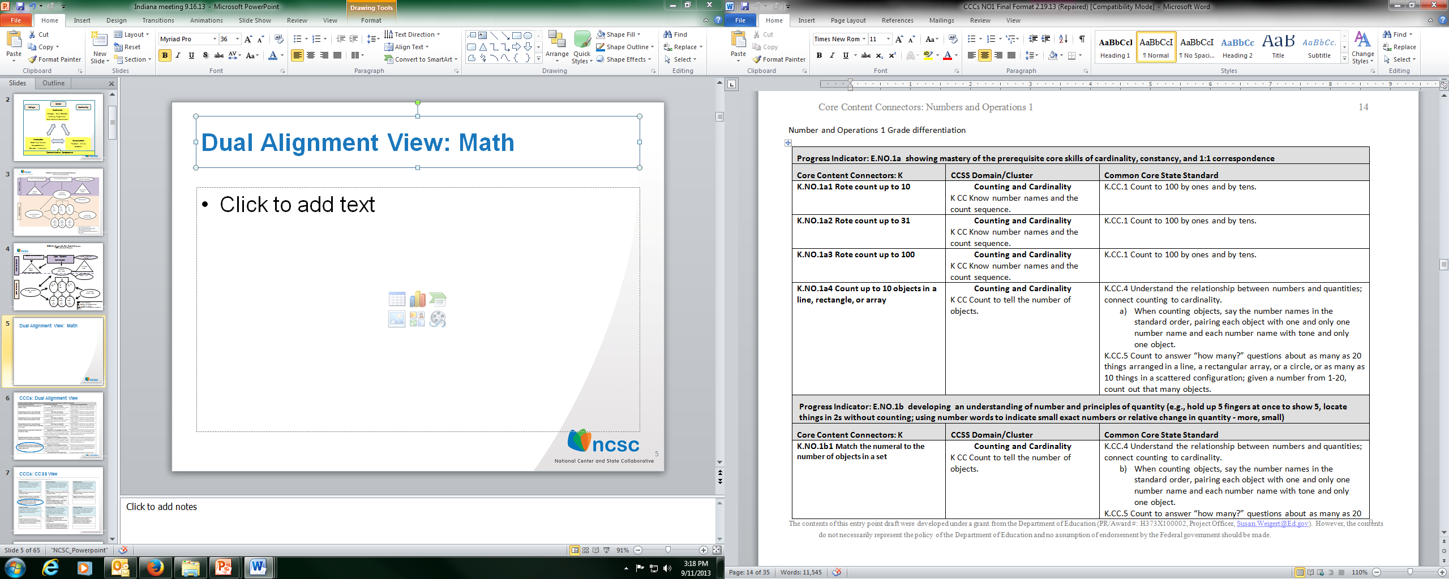
Dual Alignment View: Math

Slide 22
SCHEMA for Common Core State Standards Resources
NCSC Instructional Resources
WHAT TO TEACH
Common Core State Standards
Core Content Connectors
Learning Progressions Frameworks
Instructional Families
Graduated Understandings
Content
Modules
Element Cards
HOW TO TEACH
Ele Unit
UDLs
MS Unit UDLs
HS Unit UDLs
Curriculum Resource Guides
Instructional Resource Guide
Ele MASSIs &
LASSIs
MS MASSIs &
LASSIs
HS MASSIs &
LASSIs
=Standards documents
= Documents that promote teacher understanding of the content
= Documents that promote instruction of the content

Slide 23
Graduated Understandings
Instructional Families:
  Provide educators with easily interpreted visual representations of the areas of curricular emphasis within and across grades; and
  Reference the CCSS and the Learning Targets of the Learning Progression Frameworks.
Element Cards:
  Define the Essential Understandings as Concrete Understandings and Representational Understandings derived from the Core Content Connectors; and
  Articulate suggested instructional strategies, supports and scaffolds.

Slide 24
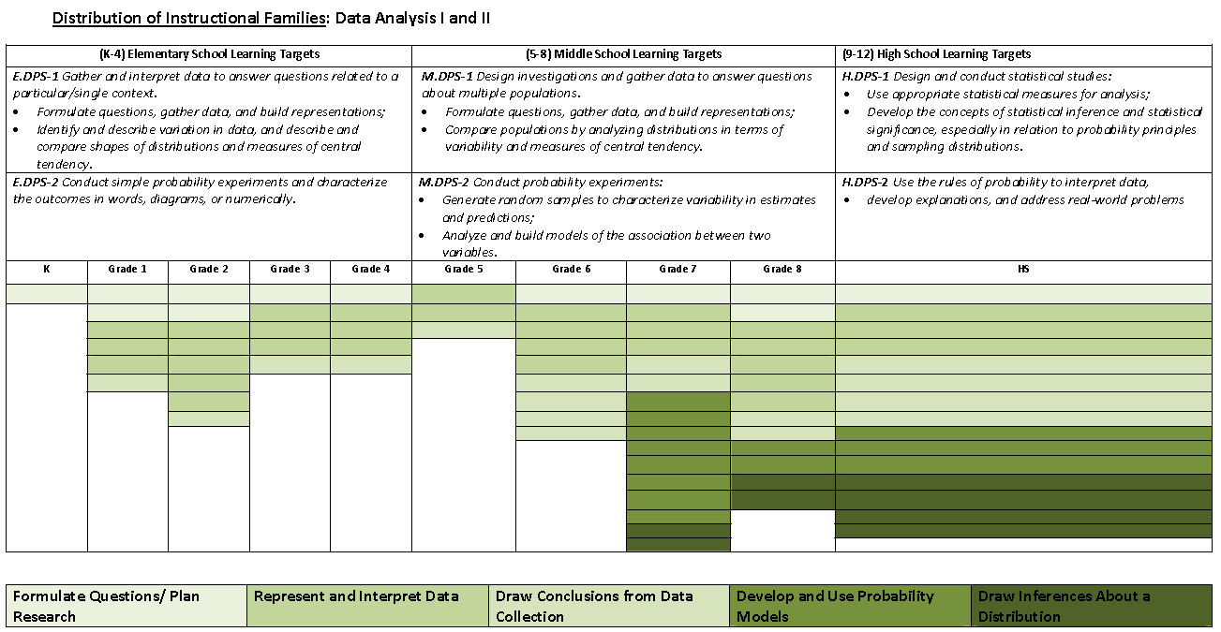
Grade-span Learning Targets from the Learning Progression Frameworks
Distribution of Instructional Families and the number of related CCCs by grade
Five Instructional families for Data Analysis I & II

Slide 25
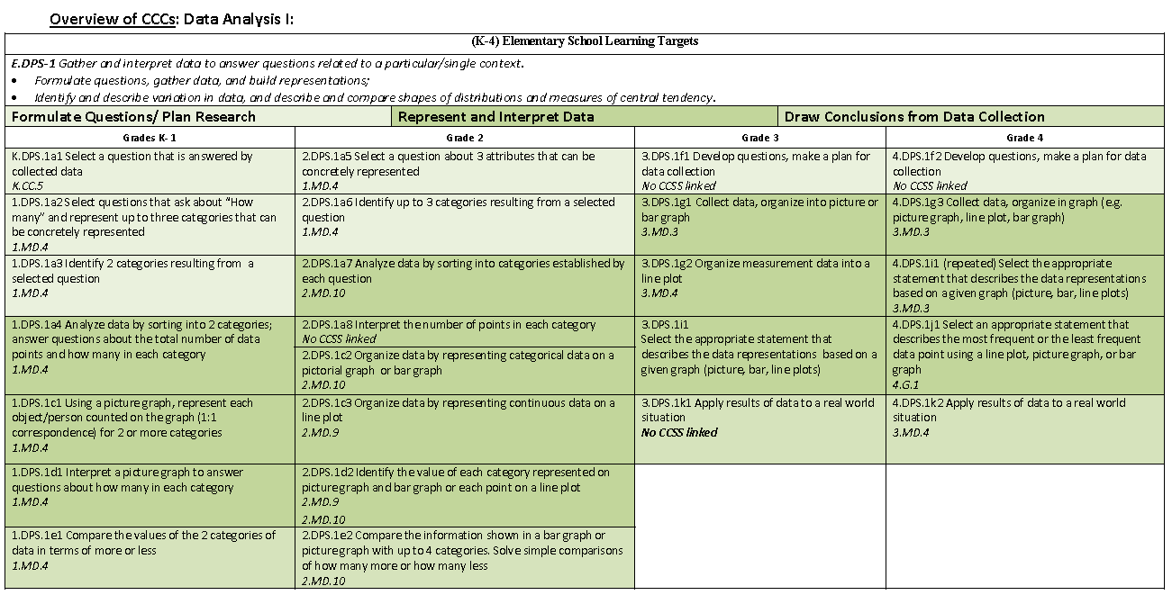
Grade-span Learning Target from the Learning Progression Frameworks
Instructional Families for Data Analysis I (K-4)
Reference to related CCSS
Distribution of CCCs by Instructional Families an grade

Slide 26
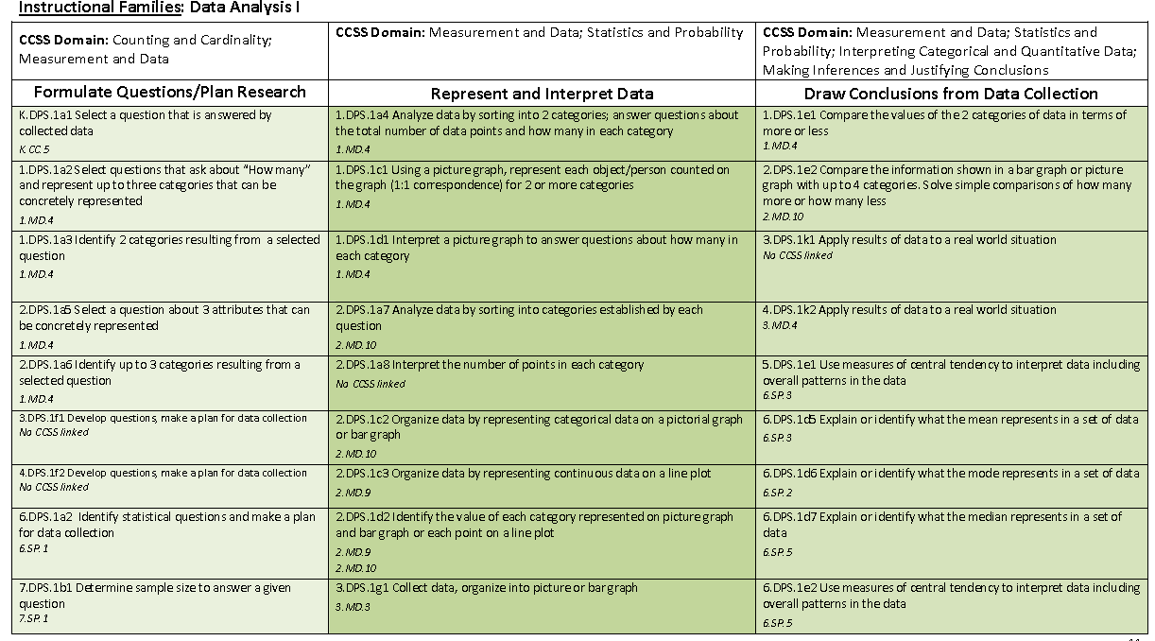
Instructional Families/CCSS Domains View
Related CCSS Domains for Data Analysis I
Three Instructional Families in Data Analysis I
Reference to related CCSS (s)

Slide 27
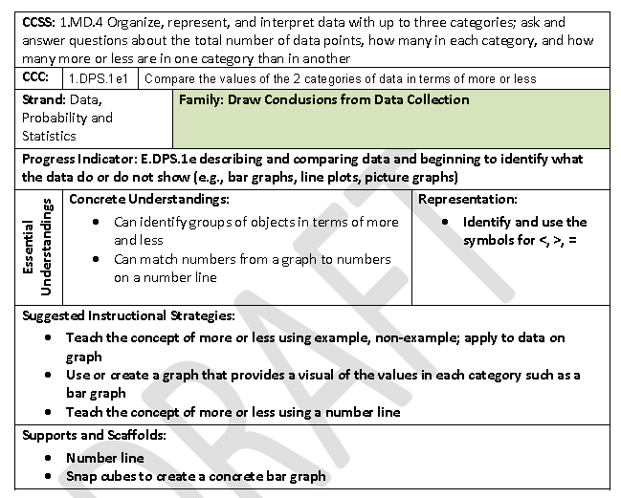
Element Cards

Slide 28
SCHEMA for Common Core State Standards Resources
NCSC Instructional Resources
WHAT TO TEACH
Common Core State Standards
Core Content Connectors
Learning Progressions Frameworks
Instructional Families
Content
Modules
Graduated Understandings
Element Cards
HOW TO TEACH
Ele Unit
UDLs
MS Unit UDLs
HS Unit UDLs
Curriculum Resource Guides
Instructional Resource Guide
Ele MASSIs &
LASSIs
MS MASSIs &
LASSIs
HS MASSIs &
LASSIs
=Standards documents
= Documents that promote teacher understanding of the content
= Documents that promote instruction of the content

Slide 29
Purpose of the Content Modules
The Content Modules are an online multimedia resource that provides teachers with a deeper understanding of complex concepts.
Content Modules make excellent companion resources when viewing the CCCs. For example, if teacher is not sure what “nets” are in geometry, a content module can be used to see explanations and examples of nets.
The Content Modules are being developed and will be available as an on-line multi-media resource that provides teachers with critical information on more complex concepts contained within the CCSS.
Because it is necessary to understand the content before teaching the content, these modules are an excellent companion resource when planning for instruction.

Slide 30
Content Modules Topics
Math
ELA
Coordinate Plane
Expressions
Factions and Decimals
Functions
Linear Equations
Perimeter, area, and Volume
Radicals and Exponents
Ratios and Proportions
Vocabulary Acquisition and Use
Text structure
Inferences and summarizing
Main idea, theme, and key details
Author’s purpose and point of view
Writing- narrative, explanatory
and persuasive

Slide 31
SCHEMA for Common Core State Standards Resources
NCSC Instructional Resources
WHAT TO TEACH
Common Core State Standards
Core Content Connectors
Learning Progressions Frameworks
Instructional Families
Content
Modules
Graduated Understandings
Element Cards
HOW TO TEACH
Ele Unit
UDLs
MS Unit UDLs
HS Unit UDLs
Curriculum Resource Guides
Instructional Resource Guide
Ele MASSIs &
LASSIs
MS MASSIs &
LASSIs
HS MASSIs &
LASSIs
=Standards documents
= Documents that promote teacher understanding of the content
= Documents that promote instruction of the content

Slide 32
Curriculum Resource Guides
The purposes of the Curriculum Resource Guides Are:
To provide guidance for teaching the Common Core State Standards (CCSS) to students with Significant Cognitive Disabilities (SWSCD) that both aligns with these standards and provides differentiation for individual student needs
To serve as a companion document to the Progress Indicators for the CCSS found in the NCSC Learning Progressions
To help educators build knowledge of the essential content reflected in these Progress Indicators of the CCSS
To delineate the necessary skills and knowledge students need to acquire to master these indicators
To provide examples for differentiating instruction for a wide range of SWSCD. These examples can be used in planning specific lessons, alternate assessment items, and professional development.

Slide 33
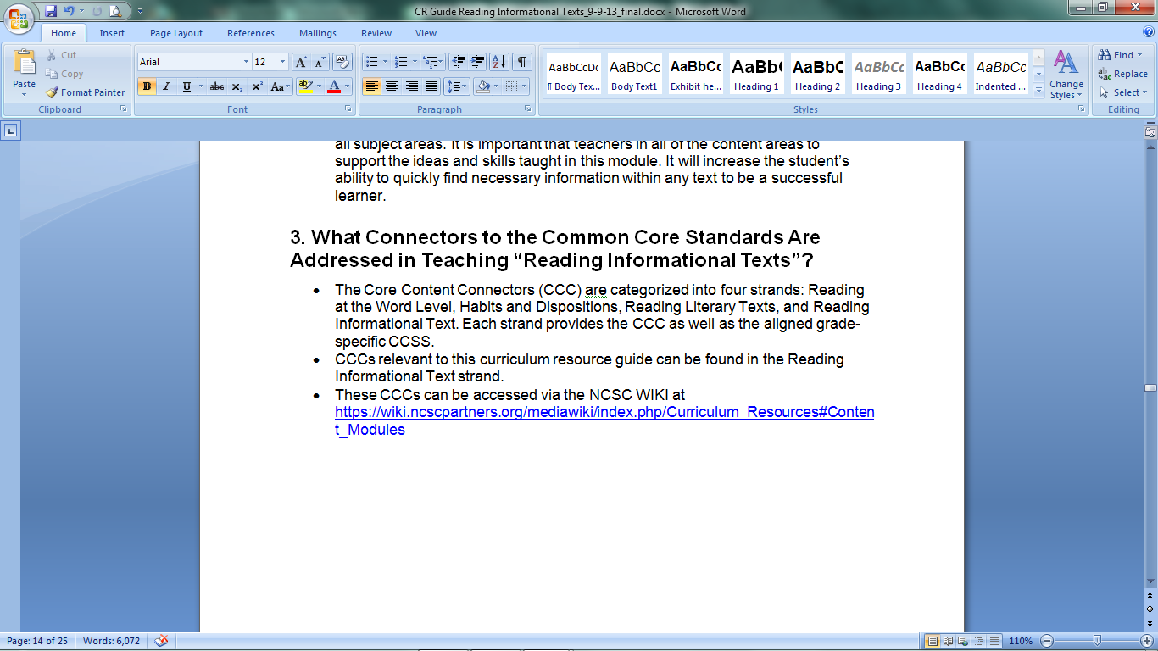
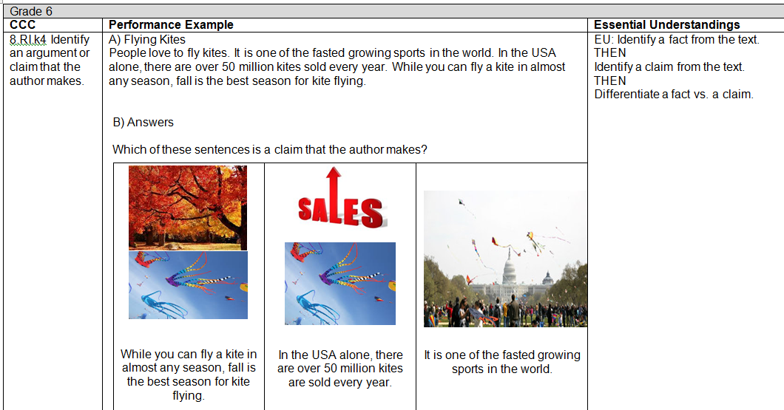
What is included in CR Guide?
Part 3 – Links to CCCs and Performance Examples
  1st section provides a description of the Reading CCCs and a hyperlink to access the CCCs
  2nd table includes sample summative assessment items related to topic
  Essential Understandings expectations are included

Slide 34
Curriculum Resource Guides
Notes:
The Curriculum Resource (CR) Guide is intended to be a support for teachers to understand how a concept (such as teaching area and surface area in the middle school grades) can be taught to students with different instructional support needs and initial understandings and how that concept changes (and therefore the instruction changes) across the grades within the grade span. Each guide covers a range of Core Content Connectors for grades 3 through high school.
These guides focus on five topics that were derived from the priorities identified by the NCSC for the Assessment. These guides should support teachers in preparing students for the NCSC alternate assessment.
This example for grade 8 in measurement shows a performance example for area.

Slide 35
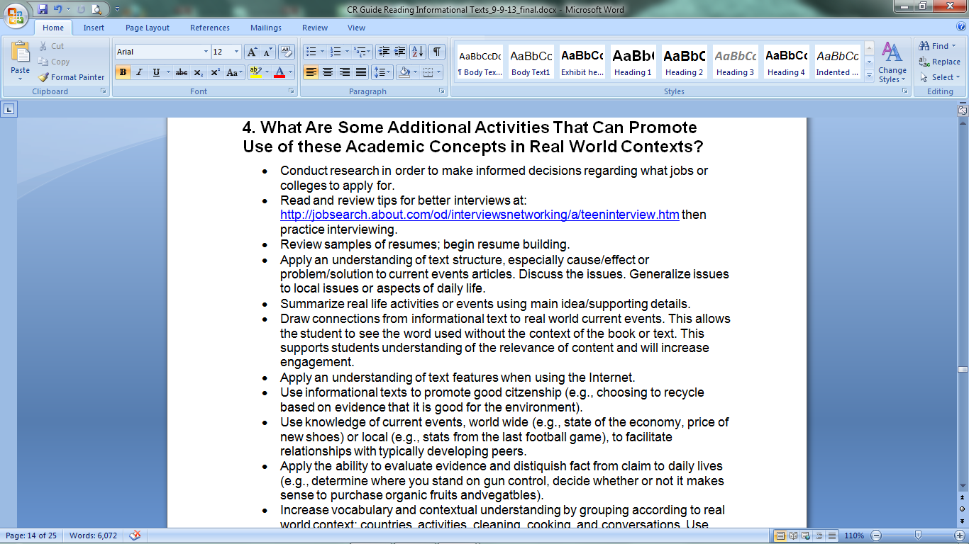
What is included in CR Guide?
Part 4 – Real World Applications
  Ideas for teachers to use to reinforce concepts in real world contexts

Slide 36
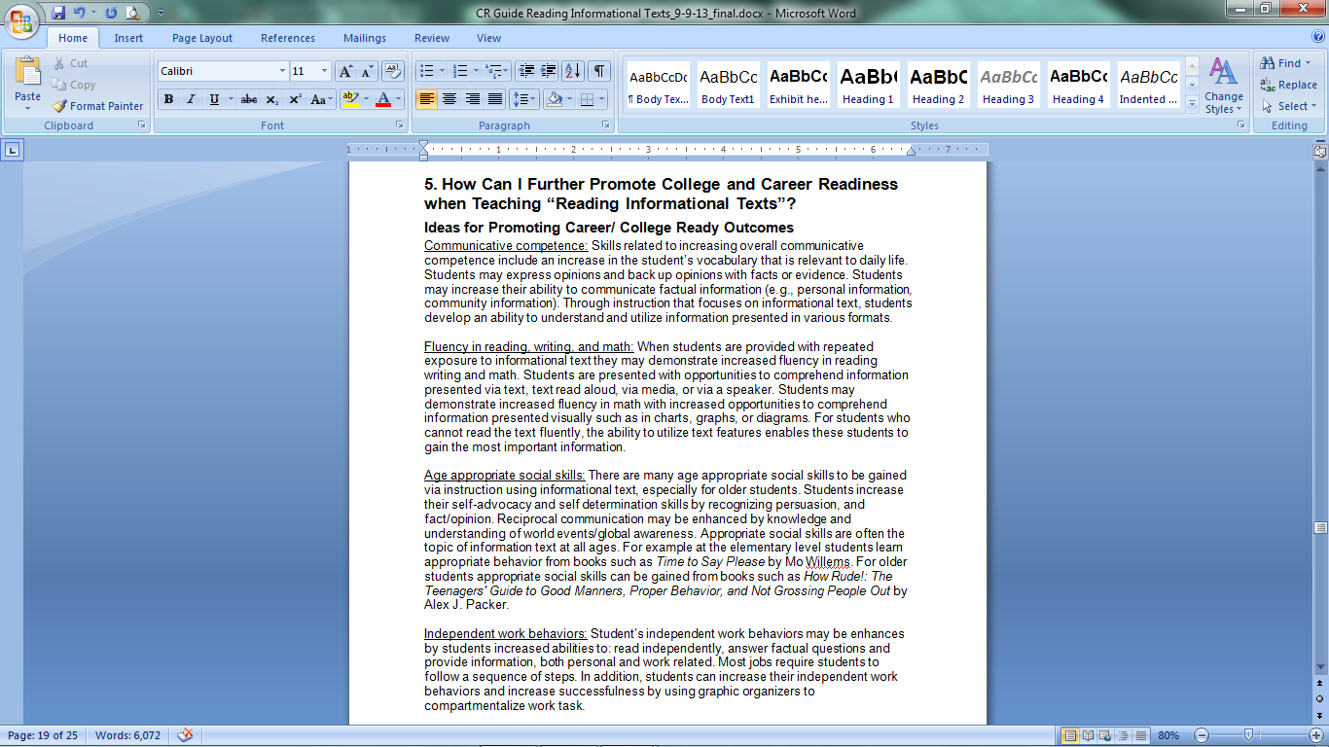
What is included in CR Guide?
Part 5 – Ideas for Promoting Career and College Readiness
  Specific to topic
  Address College and Career Ready Outcomes:
    Communicative competence
    Fluency in reading, writing, and math
    Age appropriate social skills
    Independent work behaviors
    Skills in accessing support systems

Slide 37
SCHEMA for Common Core State Standards Resources
NCSC Instructional Resources
WHAT TO TEACH
Common Core State Standards
Core Content Connectors
Learning Progressions Frameworks
Instructional Families
Content
Modules
Graduated Understandings
Element Cards
HOW TO TEACH
Ele Unit
UDLs
MS Unit UDLs
HS Unit UDLs
Instructional Resource Guide
Curriculum Resource Guides
Ele MASSIs &
LASSIs
MS MASSIs &
LASSIs
HS MASSIs &
LASSIs
=Standards documents
= Documents that promote teacher understanding of the content
= Documents that promote instruction of the content

Slide 38




What is Included in IR Guide?
Overview of Systematic Instruction
Importance of Finding a Response Mode
Explanation of Instructional Strategies and “how to”
Provides sample script for math and ELA skill for each instructional strategy
Troubleshooting Q&A
Constant Time Delay (CTD)
System of Least Prompts (LIP)
Model, Lead, Test
Example/Non-example Training

Slide 39
SCHEMA for Common Core State Standards Resources
NCSC Instructional Resources
WHAT TO TEACH
Common Core State Standards
Core Content Connectors
Learning Progressions Frameworks
Instructional Families
Graduated Understandings
Content
Modules
Element Cards
HOW TO TEACH
Ele Unit
UDLs
MS Unit UDLs
HS Unit UDLs
Curriculum Resource Guides
Instructional Resource Guide
Ele MASSIs &
LASSIs
MS MASSIs &
LASSIs
HS MASSIs &
LASSIs
=Standards documents
= Documents that promote teacher understanding of the content
= Documents that promote instruction of the content

Slide 40
UDL Units in Mathematics
Math UDL Units | Grades | # of lessons | Topics/Skills
Elementary: Area and Perimeter | 3-4 | 4 lessons and a culminating activity | Standard units of measure, converting units within the same system, and area and perimeter
Middle: Surface Area and Volume | 6-8 | 4 lessons and a culminating activity | Attributes of shapes, area of complex shapes, and surface area and volume of three-dimensional shapes
High School: Investigating Density in Real World Situations | 9-10 | 5 lessons and a culminating activity | Area and perimeter, converting units, ratios and proportions, and unit rate (density)

Slide 41
ELA – UDL Units and lessons
ELA UDL Units | Grades | # of Lessons | Topics/skills
Elementary: Saturdays and Teacakes | 3-4 | 4 lessons and 1 culminating activity | Character, setting and Key details
Middle: Life on the Mississippi | 6-7 | 3 lessons and 1 culminating activity | Identifying an Author’s purpose through reading comparisons
High School: Spreading the News | 9-10 | 4 lessons and 1 culminating activity | Writing with a purpose and identifying bias

Slide 42
UDL Unit Plans/ Lesson Plans
UDL units include sample daily lesson plans and are developed for the entire general education class to be inclusive of ALL students:
  Model how to plan for all students from the onset of instructional planning (universally designed learning) including students in AA-AAS;
  Excellent for co-teaching and collaborative planning;
  Promote inclusive instruction by showing how all students can participate - even those in AA-AAS can receive instruction in the general education; and
  Developed by University of Kentucky.

Slide 43
UDL Unit: Daily Lesson Plans: The principals of UDL and examples of modified and adapted general education lessons
Multiple Means of Representation give learners various ways of acquiring information and knowledge and provide options for expressive skills and fluency. For example: Provide students with a Context Clues Place Mat graphic organizer, digital version of the text on computer, and an online dictionary
  Multiple Means of Action and Expression provide learners alternatives for demonstrating what they know and provide options for recruiting interest, sustaining effort, and self regulation. For example: Have students record information using various formats: Alpha Smart, graphic organizer (Context Clues Place Mat), etc.
Multiple Means of Engagement give learners various ways of acquiring information and knowledge and provide options for comprehension by the highlighting of critical features. For example: Have students work in small groups and use on-line versions of the text. Ensure each student is actively involved in his/her partnership.

Slide 44
The UDL lessons show how to modify and or adapt for both Emerging Readers and Emerging Communicators
Emerging Readers
Emerging Communicators
A student who consistently uses words, pictures and or tactile representations
For example: Provide picture and/or tactile representations of relevant vocabulary, paired with the written word, each time a salient concept/vocabulary word is mentioned during the presentation or discussion, as well as the meanings of each word.
A student who inconsistently uses a communication system
For example: Provide the student with manipulatives and or tactile representation for each key word or detail that is consistent with the student’s mode of communication . **As students work in small groups or pairs, ensure they have a means for gaining their group members’ or partner’s attention and a means for contributing to the discussion

Slide 45
NCSC UDL Unit Concept Reinforcement Activity for Mathematics and ELA
If the student has not had experience (or has had very little experience) with a concept or needs a review, it might be helpful to provide instruction using this Concept Reinforcement Activity (CRA) before the Introduction to Lesson 1 and Lesson 3.
  Just as with any other student, it is unlikely that he/she will learn this concept or skill after being instructed only once so you can provide the activity at other times during the unit.
  Do not expect or require mastery of this CRA before the student takes part in the unit.
  The CRA is supplemental instruction and should only be provided in addition to the instruction in the unit; it does not take the place of the unit.

Slide 46
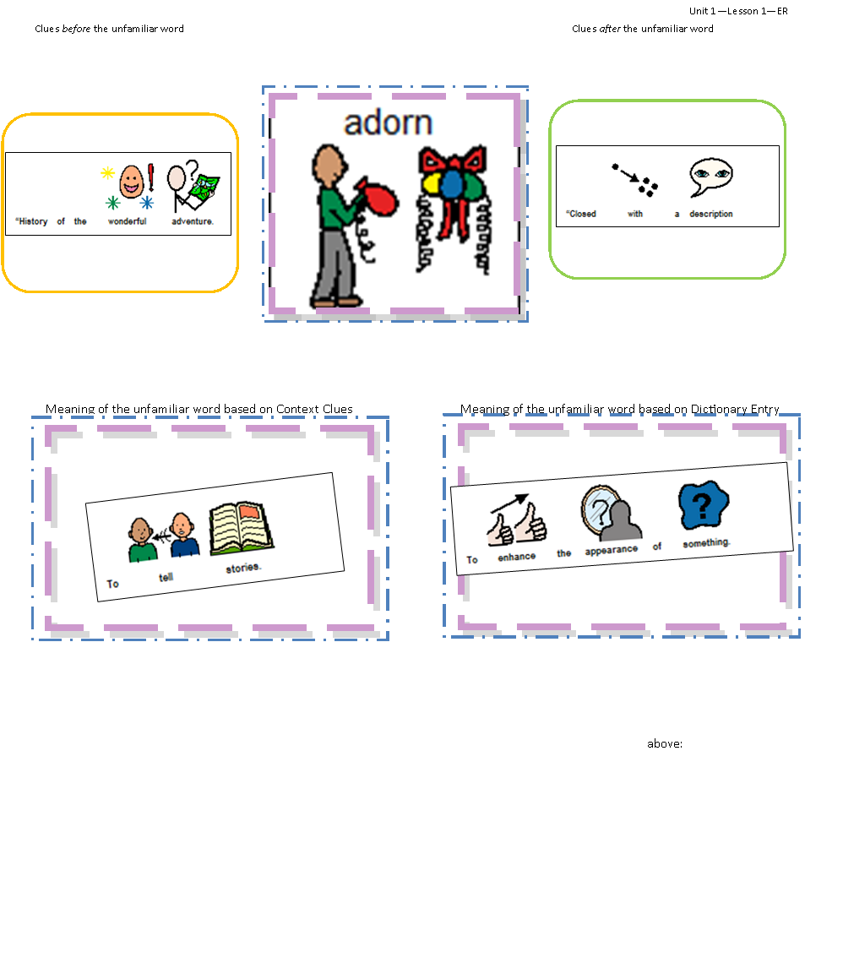
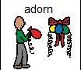




Unit 1—Lesson 1—ER
Clues before the unfamiliar word
Clues after the unfamiliar word
Meaning of the unfamiliar word based on Context Clues above:
Meaning of the unfamiliar word based on Dictionary Entry
above:

Slide 47
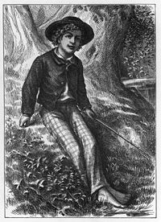

The Adventures of Tom Sawyer
Next page
By: Mark Twain
Chapter 32
Turn Out!
They’re Found!
Excerpt
Look for opportunities for student interaction in the yellow box on each page.
Touching correct answers will animate the image. Try this one:
(Make sure your volume is on.)

Slide 48
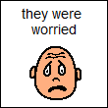
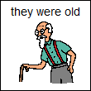
Next page
Becky’s mother, Mrs. Thatcher was so worried about her daughter that she had become sick.
Tom’s Aunt Polly was quiet and sad and her worry had turned her grey hair white.
Why was Mrs. Thatcher sick and Aunt Polly’s hair white?

Slide 49




PREDICTION
What will happen to Tom and Becky?
Next page
They will never be found.
They will escape the cave and will learn how to live in the forest.
They will escape the cave and be rescued by men on a river boat.
Injun Joe will catch them and hurt them.

Slide 50
The UDL Units
Mathematics and ELA are supported by a 5 Step Process to develop lessons that;
  assists teachers in identifying aligned general education lessons to adapt,
  Individualizes supports while promoting full participation, and
  shows when and how to use all the resources available

Slide 51
5 Step Process
Identify the standard(s) in the gen ed lesson.
  Use Content Modules to clarify content.
  Use the Graduated Understandings: Instructional Families.
Identify the outcomes or learning objectives for All students.
  Use Content Modules to clarify content.
  Use the Curriculum Resource Guides for descriptions of outcomes.
  Use the Element Cards for Essential Understandings
Examine the instructional activities for All students.
    Use UDL Units for examples of instructional activities that make up a unit
    Use Curriculum Resource Guide for additional instructional activities ideas.
Determine supports for SCD.
  Use the UDL Units for multiple means of representation, expression, and engagement and for additional support considerations.
Use NCSC curriculum and instructional resources as needed.
  Use the Element Cards for instructional strategies
  Use the MASSIs to reinforce specific skills and concepts
  Use the Instructional Resource Guide to design systematic instructional strategies

Slide 52
SCHEMA for Common Core State Standards Resources
NCSC Instructional Resources
WHAT TO TEACH
Common Core State Standards
Core Content Connectors
Learning Progressions Frameworks
Instructional Families
Content
Modules
Graduated Understandings
Element Cards
HOW TO TEACH
Ele Unit
UDLs
MS Unit UDLs
HS Unit UDLs
Curriculum Resource Guides
Instructional Resource Guide
Ele MASSIs &
LASSIs
MS MASSIs &
LASSIs
HS MASSIs &
LASSIs
=Standards documents
= Documents that promote teacher understanding of the content
= Documents that promote instruction of the content

Slide 53
LASSIs: Scripted Systematic Instruction
Scripted response options are provided at the end of each section of an activity.
AT to be used as needed
Adapted texts are provided; original articles for the informational LASSIs
Suggestions:
Add picture supports to text if needed, but we encourage you to try without first
Augment using objects for students with the most severe disabilities or multiple disabilities
Builds in key vocabulary, phonetic awareness and basic concepts
Builds toward grade level competence

Slide 54
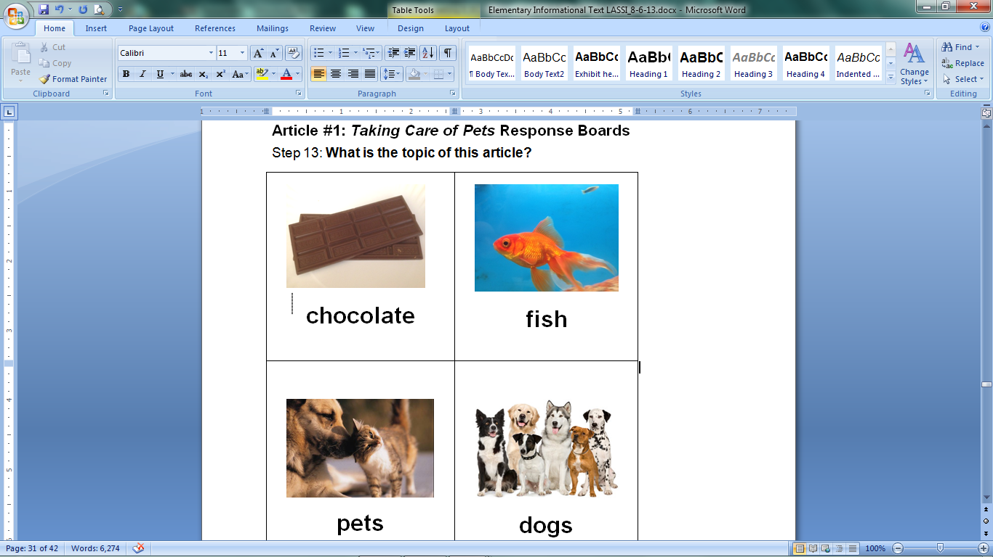
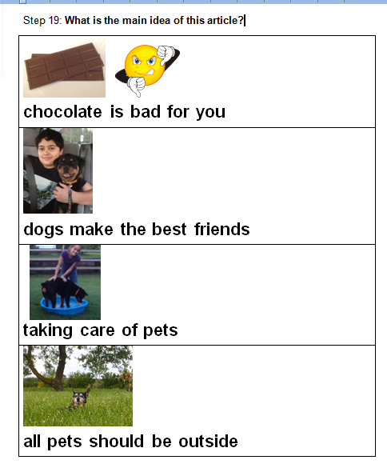
SAMPLE RESPONSE BOARDS

Slide 55
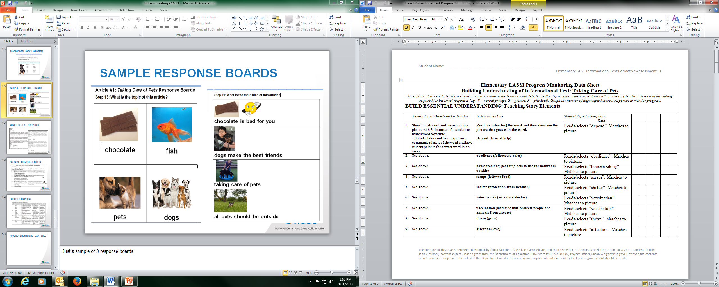
PROGRESS MONITORING DATA SHEET

Slide 56
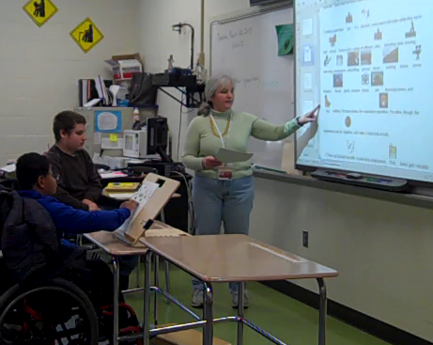
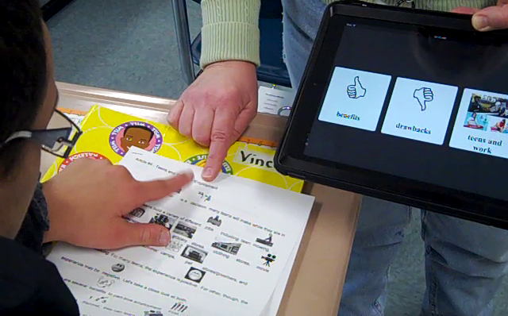
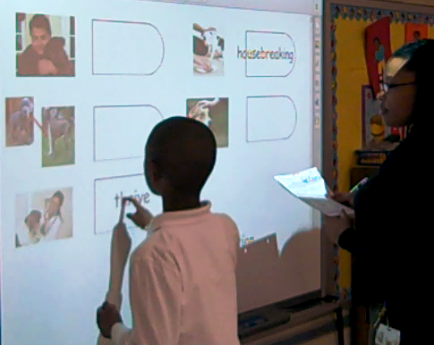

LASSIs and Technology
Clockwise left to right: Teachers use an interactive whiteboard to present text. A notebook is used to present response options. Student makes selection on notebook. An interactive whiteboard is used to match vocabulary word to pictorial representations.

Slide 57
More information to come
Watch the WiKi site for additional resources!
https://wiki.ncscpartners.org/mediawiki/index.php/Main_Page

Slide 58
Thank You! sarah.kennedy@uky.edu
The contents of this presentation were developed under a grant from the Department of Education (PR/Award #: H373X100002, Project Officer, Susan.Weigert@Ed.gov). However, the contents do not necessarily represent the policy of the Department of Education and no assumption of endorsement by the Federal government should be made.

